Slide 1
quiz game
quiz game
Niranjan chand
Here is where your presentation begins

Slide 2
Purpose of project
Purpose of project
01
The main purpose of this project is to enhance, increase and test the general knowledge of the users.
02
We can test our general knowledge and can get reward for the correct answers.
03
This project mainly focus on the school children.

Slide 3
Scope of project
1. To test the general knowledge of the users.
2. To provide entertainment and reward for the correct answer.
3. To boost the thinking ability of the users.
4. To utilize the free time of the users.
5. To minimize the use of text book.
6. To provide a user-friendly environment where user can be serviced better.

Slide 4
01
Features
Features
You can enter a subtitle here if you need it

Slide 5
1. User can run it anytime and play it.
2. Consists of many option including start, view the highest score, restore the score, quit etc.
3. User can get help from the “help” option.
4. User can register his/her name.
5. Basic instruction is highlighted before playing game.
5. There will be warmup round and challenge round.
6. To play challenge round user must pass the warmup round having 3 questions and user should make atleast 2 correct answer.
7. In challenge round you have 10 question and each correct answer will be awarded Rs.100.
8. In this way, users can make total of Rs.1000.
9. No negative marking for wrong answers.

Slide 6
02
Flowchart
Flowchart
You can enter a subtitle here if you need it

Slide 7

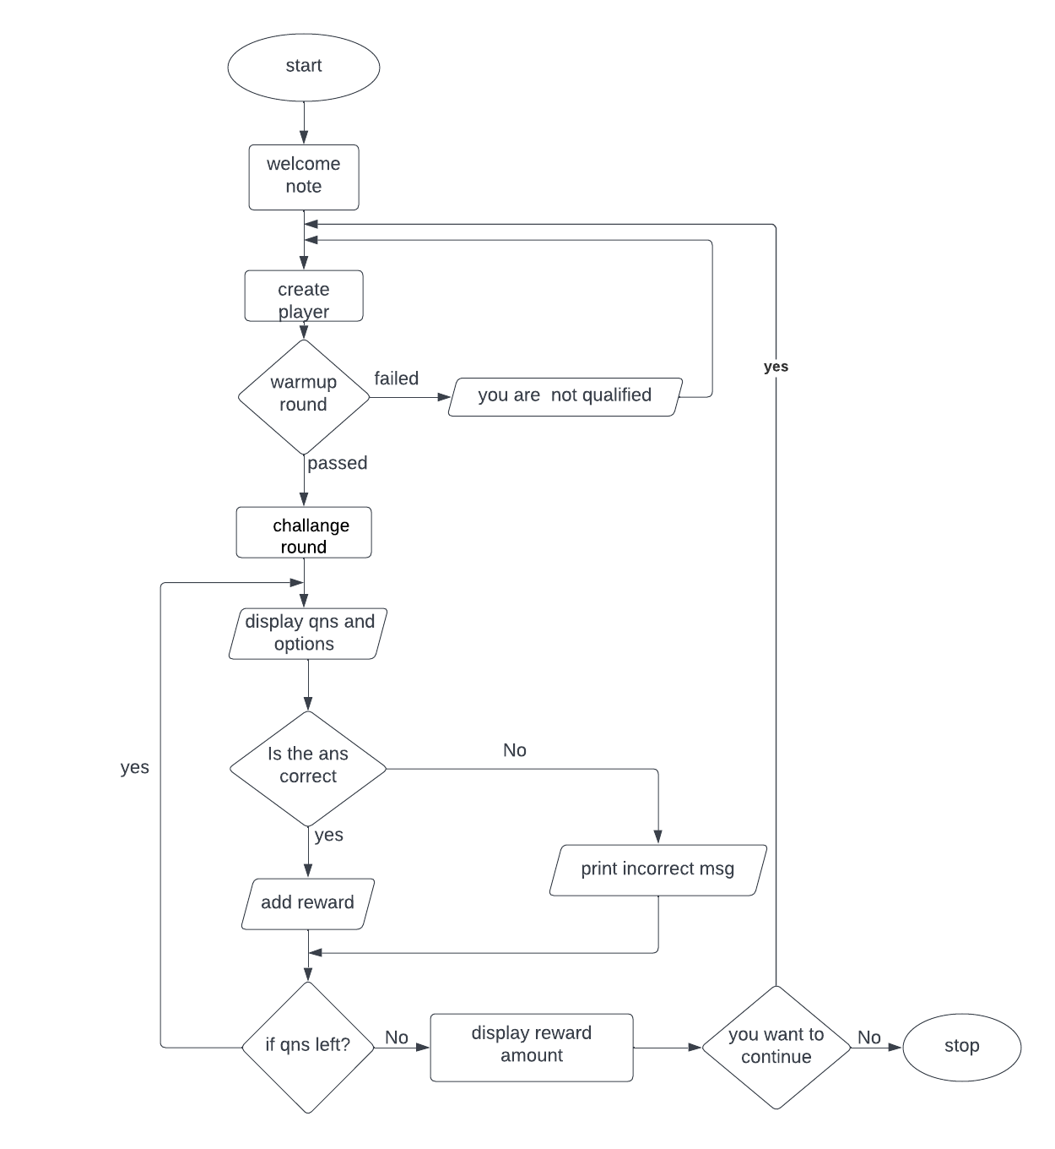

Slide 8
Expected output
Expected output
Welcome To The Game
BECOME A RICH PERSON!!!!!!!!!!!!!
> Press S to start the game.
> Press V to view the highest score.
> Press R to reset score.
> Press H for help.
> Press Q to quit.

Slide 9
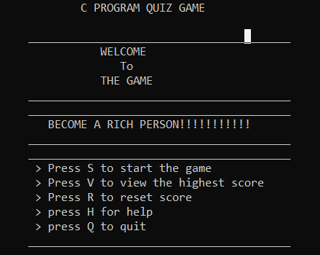
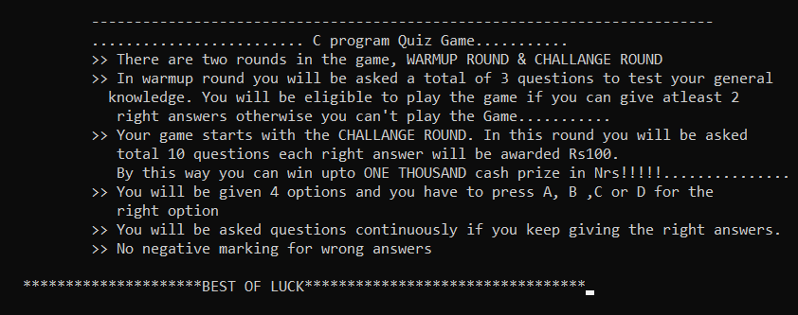
Glimpse of output
Glimpse of output

Slide 10
conclusion
conclusion
After completion of this project we can play the Quiz game. Students will be benefited with this project. They can test their IQ level and collect some amount of money. This project can be hired by every School for learning purposes.

Slide 11
Thanks!
Thanks!
Please keep this slide for attribution

